Slide 1
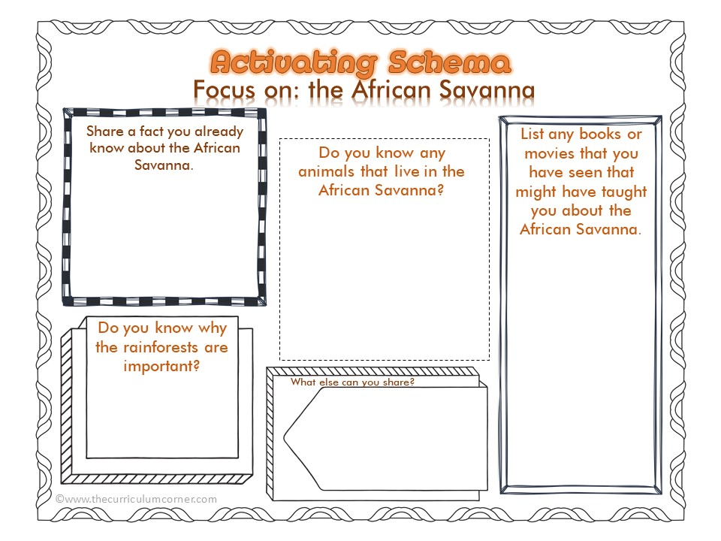
Write answer here
Write answer here
Write answer here
Write answer here
Write answer here

Slide 2
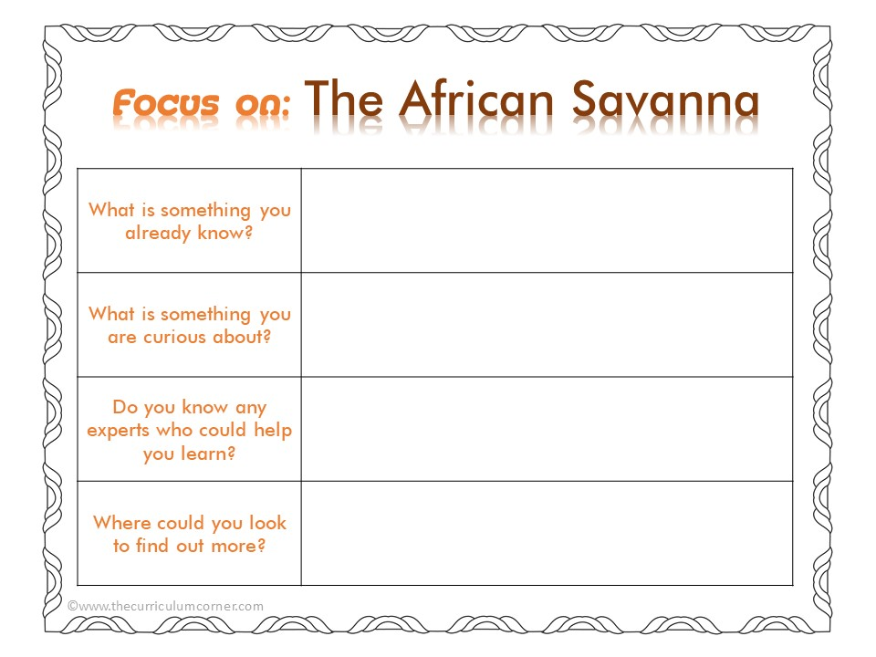
Write answer here
Write answer here
Write answer here
Write answer here

Slide 3
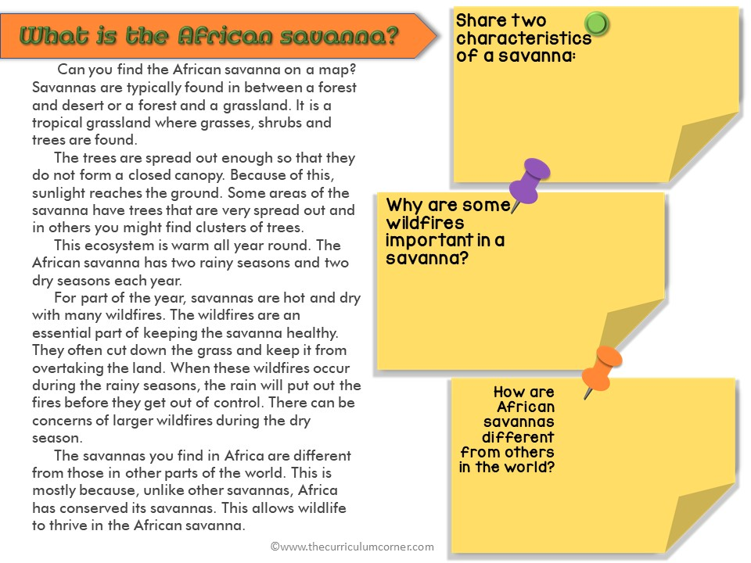
Write answer here
Write answer here
Write answer here

Slide 4
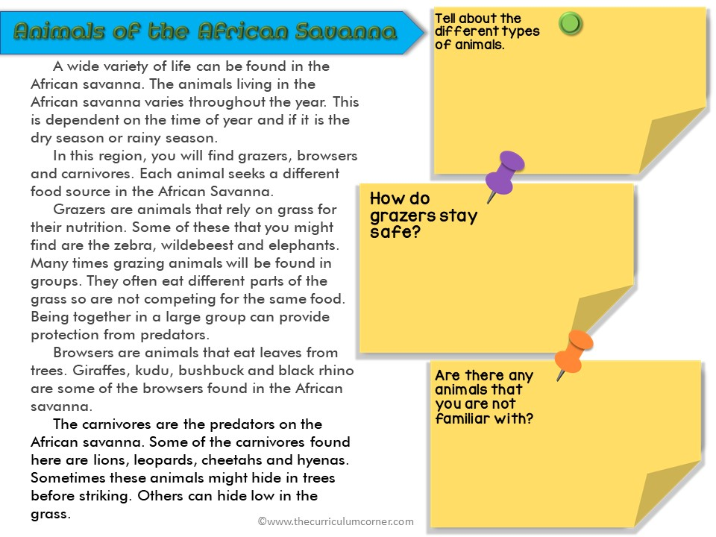
Write answer here
Write answer here
Write answer here

Slide 5
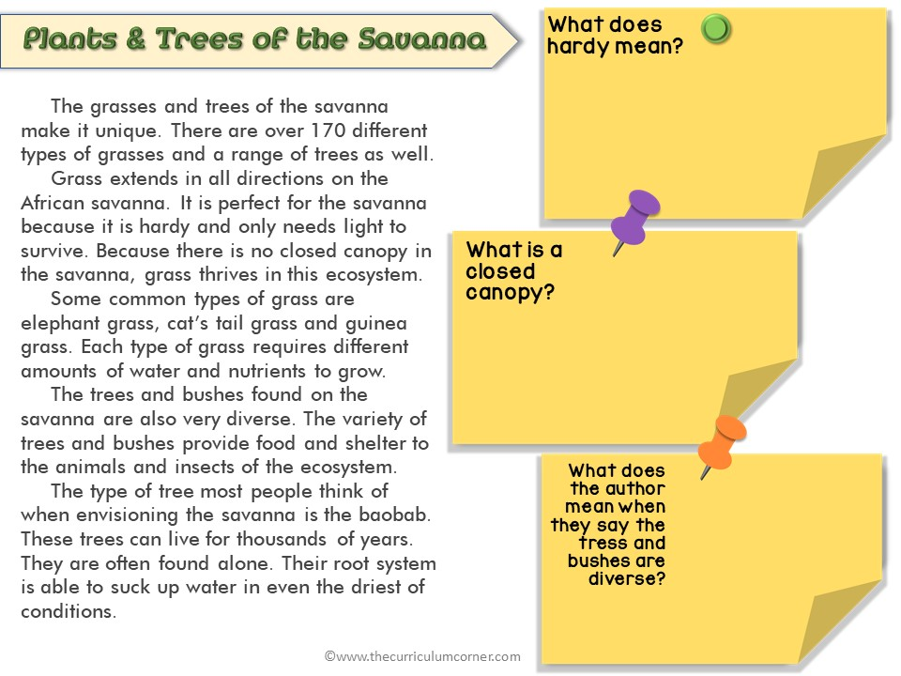
Write answer here
Write answer here
Write answer here

